Slide 1
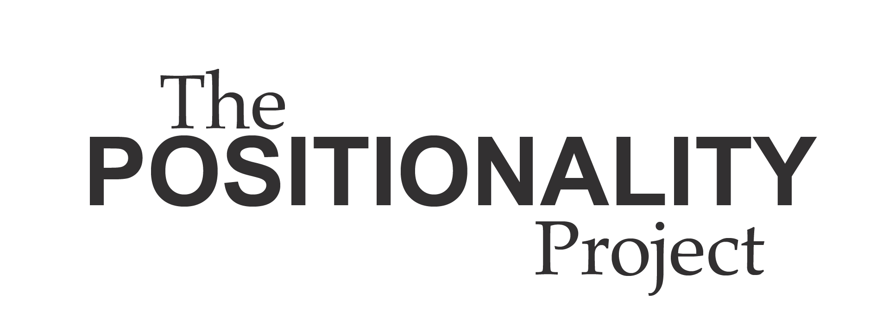




Slide 2
Disclaimer
This presentation was prepared for the South Southwest Mental Health Technology Transfer Center (MHTTC) under a cooperative agreement from the Substance Abuse and Mental Health Services Administration (SAMHSA). All material appearing in this presentation, except that taken directly from copyrighted sources, is in the public domain and may be reproduced or copied without permission from SAMHSA or the authors. Citation of the source is appreciated. This presentation will be recorded and posted on our website.
At the time of this presentation, Dr. Miriam Delphin-Rittmon served as the Assistant Secretary for Mental Health and Substance Use in the U.S. Department of Health and Human Services and the Administrator of SAMHSA.
The opinions expressed herein are the views of the speakers, and do not reflect the official position of the Department of Health and Human Services (DHHS), or SAMHSA. No official support or endorsement of DHHS, SAMHSA, for the opinions described in this presentation is intended or should be inferred.
This work is supported by grant 6H79SM081778-05 from the DHHS,SAMHSA.

Slide 3
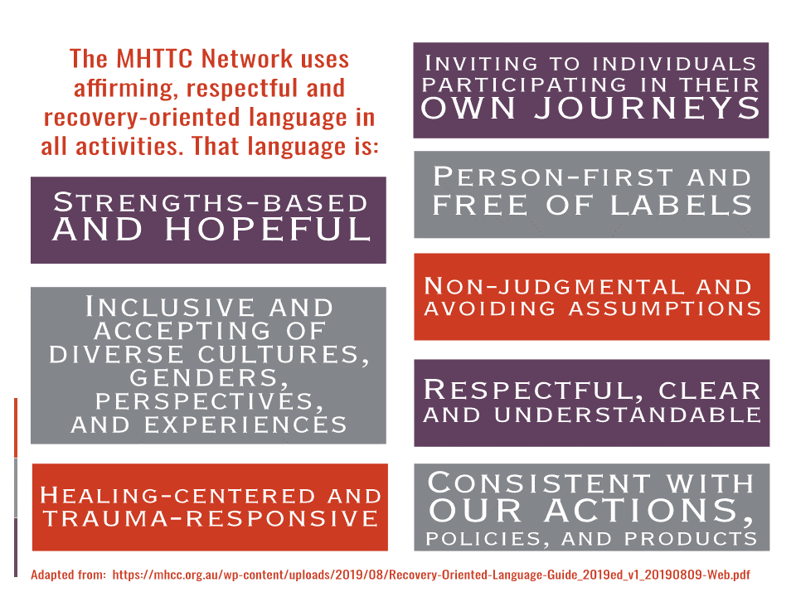

Slide 4
What is positionality?
“Positionality refers to the stance or positioning of the researcher in relation to the social and political context of the study—the community, the organization, or the participant group. The position adopted by a researcher affects every phrase of the research process, from the way the question or problem is initially constructed and acted on and, finally, the ways in which outcomes are disseminated and published... positionality, defined in terms of the degree of relatedness to the researcher to the study participants along dimensions of culture, class, gender, age, religion, sexual orientation, childhood lived experiences, and so on.” (Coghlan & Brydon-Miller, 2014).

Slide 5
Positionality refers to the social positions we hold
  Examples of social positions include race, ethnicity, class, gender, socioeconomic status, political affiliation, educational attainment, (dis)ability, nationality, and sexual orientation
Social positions are socially, historically, and linguistically constructed
Positions can bring privileges and/or disadvantages
Positionality influences
  Our experiences and perceptions
  How we relate to others
  How others relate to us
How others perceive our social positions may not always reflect our true identity
Positionality is an iterative, constant process
Positionality goes beyond reflection; it requires actions

Slide 6
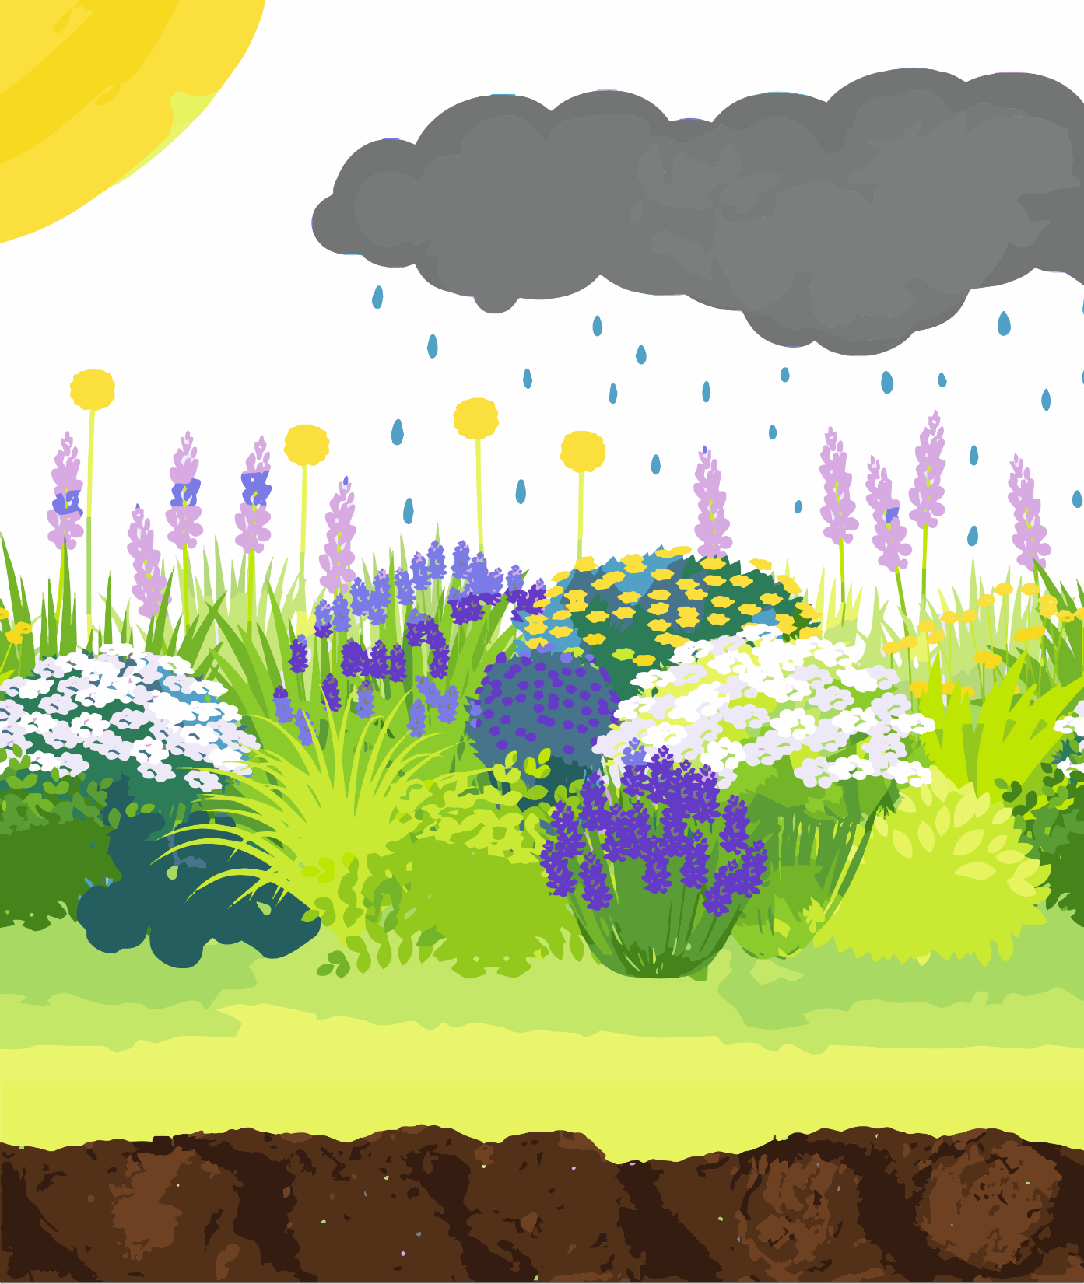
The Garden of Positionality Metaphor
Each component of this image represents a different aspect of positionality:
  Sunlight
  Seasons
  Raincloud
  Tall Grass
  Types of Plants
  Garden
  Ground Cover
  Soil
Notes:
Garden
The garden represents a community. We can think of each individual flower as an individual person. Each plant has a unique, intersectional experience of the sun, rain, soil, and interacts with other plants. A garden plot can be lush and thriving if each plant is given what it needs to grow through intentional labor—this approach would be considered equity. Cultivating a lush garden plot requires attending to the needs of each plant and how the plants interact. Although equity is a solution to imbalanced ecosystems, gardens can be restructured and root causes of inequity removed. Justice would involve restructuring the garden so that barriers to equality are eliminated.
Plant Type
Each type of plant represents different social positions. All of the plants share one aspect of their positionality—just as we all share the position of being human—and they all need certain basic resources like water, light, space, and nutrients. However, different types of plants may have different experiences, needs, or treatment within the garden. All plants interact with and influence each other, just as our different social positions intersect. Although plant science may place judgments on different types of plants, we ask that the reader not extend the metaphor in this way, which would be inappropriate for humans. Unlike plants, social positions are socially constructed.
Sunlight
Sunlight represents the way each organism is seen by others and the way in which social constructs are projected onto the individual. Just as the sun touches every living thing in the garden, cultural processes, like categorizing race and gender, influence everyone. Although the sun may be gentle and warming, there is also no way to escape the sun, and it can burn the plant. Although every plant needs some degree of sunlight, unrestrained light can actually cause harm. To some extent, social categories may help us to self-identify, find community, and identify patterns across broader social systems; however, categorizations can also be harmful. We are always seen and interpreted by others through the lens of culture, language, time, and place.
Rain cloud
The rain cloud represents how our environment changes. Although our positionality remains relatively stable day-to-day, the way others interpret and treat those positions changes based on environmental factors. Rain may nourish some plants to grow and blossom, whereas others may be drowned in too much water. The plants that surround us may also influence the way we experience the rain.
Seasons
The seasons represent the way our positionality can change over longer periods of time. We may develop physical or psychiatric disabilities, immigrate to other countries, transition genders, or acquire educational degrees, and we will all age and die.
Tall Grass
The tall grass represents a position of privilege in our society. Throughout history, the tall grass has accessed more resources. It can thrive in the environment as it is currently set up—in fact, the garden is designed to protect this grass. However, the grass may monopolize resources and prevent other plants from easily taking hold. As a result, other plants may need more investment now to flourish within the garden. We may even need to try new ways of gardening and think about what other kinds of ecosystems we could grow that nourish all plants (i.e., justice).
Ground cover
The grass represents the possibility of solidarity across different positionalities within our community. When plants work symbiotically, each living being receives the care and resources needed and each position within our ecosystem is valued. Differences strengthen the community and enrich the environment.
Soil
The soil represents the history in which all of us are embedded. It holds traces of the beings and processes that have come before us, and it subtly structures our society. Certain soils may contain more nutrients than others because of historical conditions–fertilizers, compost, erosion control–representing how certain plants have inherent access to more resources. Just as the soil resides under the ground, systemic oppression may also be obstructed from view. Different plants may need different types of soil to grow best. A mismatch between the type of soil and plant can create inequity.

Slide 7
Debunking Common Myths About Positionality
Myth: Positionality is most important for people from minoritized groups.
FACT:
We are all influenced by our positionality, whether or not we have reflected on it. Our social positions that carry privilege or power may influence how others view or treat us in mental health settings. Reflecting on such positions may help us to work with others across lines of difference. We also want to understand how social positions that have led to experiences of marginalization or discrimination may influence our perceptions in a mental health setting.

Slide 8
Myth: A person’s positionality is either privileged or not privileged.
FACT:
We all have multiple social positions, some of which may carry different levels of privilege or lack thereof. For example, in the United States, someone may be privileged by being White and, cisgender, but also have experienced marginalization due to low socioeconomic and disability status. Intersectionality helps us to consider how multiple social positions may influence experiences.
Myth: Positionality is a completely subjective and personal process.
FACT:
Positionality refers to our experience in relation to socially constructed categories of class, race, gender, education, sexuality, religion, and other factors. Our individual experiences of the world are unique; it can be very vulnerable or even painful to share aspects of our personal histories with colleagues and strangers. However, these experiences can be meaningful to our shared work; applying positionality will be most effective if we attempt to see our experience in relation to socially- constructed categories.

Slide 9
Myth: Positionality is only about naming our social positions.
FACT:
We must examine how these socially- constructed categories influence us and our work. Although naming social positions may be a first step, positionality challenges us to explore how our social positions have influenced our ideas, the way we interact with others, and the ways that others interact with us in clinical, research, and advocacy settings.
Myth: The work of positionality eventually ends.
FACT:
Positionality is an ongoing, constant process. As mental health providers, researchers, and advocates, we must continually reflect on how our positionality is shaping different forms of our work over time. Our positionality may change over time and in different mental health contexts.

Slide 10
Why is Positionality Important?
Identify our own biases and limitations
Work effectively across lines of difference
Provide culturally-responsive mental health services
  Reduce risk of inappropriate diagnosis or services
Increase impact and inclusivity of our work
Deepen our understanding of social determinants of health
Reduce stigma and inequity
Center lived experience and marginalized identities

Slide 11
Positionality in Action
Scenario:
Dr. Anne is a researcher studying access to treatment for psychosis in urban areas. As a graduate student in the mid ‘90s she felt alienated from “hard sciences” because the field was male dominated, so she identifies strongly as a woman in STEM and has volunteered her time building a professional organization for young women scholars. She is taken aback when a graduate student researcher points out some gaps in her analysis: her research focuses primarily on Black women but does not explicitly theorize race, erases trans and gender-nonconforming experiences, and only cites and references white male researchers. The student wants to include qualitative data to supplement and develop the research program to make it more reflective and useful to participants.
Upon reflection and reading, Dr. Anne realizes that growing up white and middle class in the rural Midwest, she was taught that it is rude to speak about or acknowledge race. She also feels afraid of being seen as “feminine” or “soft” in a research setting by including qualitative data and is concerned about losing power and ability to affect change if she produces less “objective” data. Because she lacks confidence in qualitative methods, she fears making an embarrassing misstep.
What can Dr. Anne do?

Slide 12
Dr. Anne can…
Find and contact other researchers with qualitative expertise and think about how to begin collaborative research
Read a wider variety of journals that prioritize publishing diverse voices and methods
Learn about the history of exclusion in her particular field (psychology)
Start a reading group in her department or lab
Learn from community organizations
Narrow the focus of her research to make it more specific to the experiences and concerns of those directly implicated by engaging with community to make it more specific
Connect with a community network or group that is looking for quantitative expertise or support and offer her skills
Recognize that positionality is a lifelong process and that making mistakes and learning to accept critique will create more effective and powerful research in the long term
Have a discussion with the student and be open to learning from their expertise
Get creative!

Slide 13
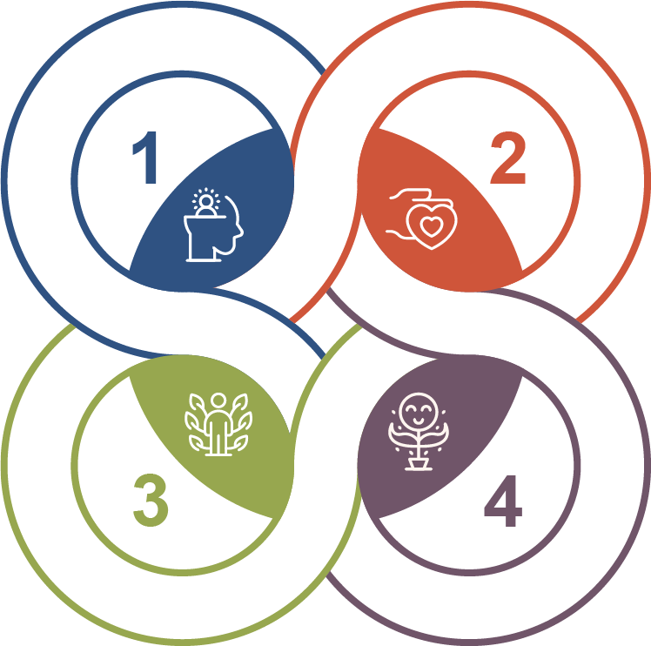
Applying Positionality
I reflect on my own positions.
I explore how positionality shapes my work and relationships and offers me certain privileges or marginalizations.
I transparently share my positionality, including limitations and specific areas of bias or expertise, as well as privileges that shape these areas.
I change my work to include other perspectives, address my own biases, and commit to learning and advancing equity.

Slide 14
Developing Your Own Positionality Statement
What social positions do you hold? What parts of your identity are important to you? Think about these various levels: society, workplace, and home.
Reflect on what ways your life and experiences have informed aspects of your positionality.
How do each of these aspects relate to privilege or marginalization?
In what ways do these positions and experiences inform your interactions with others (e.g., peers, co-workers, participants, clients)?
  Do you share (or not share) any positions with the individuals in these settings?
How has your positionality been consequential to the work you do in mental health?
  Think about what led you to work in your current space.
  How has this work and these spaces changed you?
  How does it inform the methods, practices, or tools you use?
  What are your areas of expertise and areas of non-expertise? In other words, where should you defer to others? Is there anywhere you have overstepped?

Slide 15
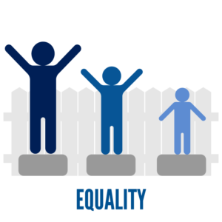
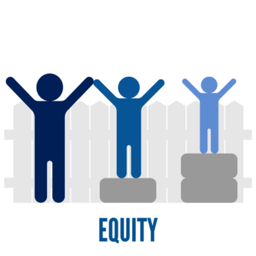

Terms to Know
Bias
The tendency to view certain ideas, things, beliefs, individuals, groups, or cultures in an unfair (i.e., overly positive or negative) and unproven way. Biases can be conscious (explicit) or subconscious (implicit). Our biases influence our thoughts, attitudes, and actions, whether we are aware of them or not. Biases are typically learned and can be institutionalized through policy and practice. Reflecting on positionality can help us become aware of some of our unconscious biases.
Equity
Equity is when each individual or group is provided with the resources or opportunities needed to reach equal outcomes. Equity involves recognizing the unique circumstances that differentially impact someone’s ability to thrive and seeks to address these barriers with tailored interventions. When social systems are unfair, equity can be a potential solution. We can use positionality to promote equity.
Intersectionality
Intersectionality is the concept that one’s social positions and identities intersect across multiple and often simultaneous levels to create a complex convergence of oppression. Social positions do not exist independently of each other; rather, each position interacts with the other to create a unique experience of oppression and privilege. Individuals can hold positions that intersect to create privilege and oppression at the same time. Intersectionality is an important component of positionality because it provides us with the framework needed to reflect on how our positions influence our relative privileges and oppressions.

Slide 16
Lived Experience
Lived experience refers to the knowledge gained through direct experience with a social or (mental) health condition as well as involvement in the services or systems aimed to address those issues. These lived experiences also frequently involve marginalization. Because people with lived mental health experience are the experts on their own recovery, we can use positionality to be cognizant of when it would be more appropriate for us to step back, listen, and allow people with lived experience to direct mental health systems, research, policies, and practices.
Marginalization
Marginalization refers to the process by which certain individuals or groups, based on their social positions, are relegated to the outer fringes of society. When an individual or group becomes marginalized, their access to resources, power, opportunities, civil rights, and safety is denied or severely limited. Marginalization can occur through prejudiced attitudes and discriminatory behaviors, policies, and practices within institutions. Positionality allows us to recognize our marginalized social positions while advocating for others with our privileged social positions.
Privilege
Privilege refers to an advantage that someone has as a result of a particular social position. Social positions that are often privileged in the United States include being White, cisgender, high socioeconomic status, able-bodied, and high education levels. A person may hold both privileged and marginalized social positions. Reflecting on one’s positionality is important to recognizing one’s privilege. These privileges may lead to unearned advantages on individual or systemic levels that are important to reflect on within mental health. (“2021 Equity Challenge Day 3: What is Privilege?,” n.d., para. 1-2).

Slide 17
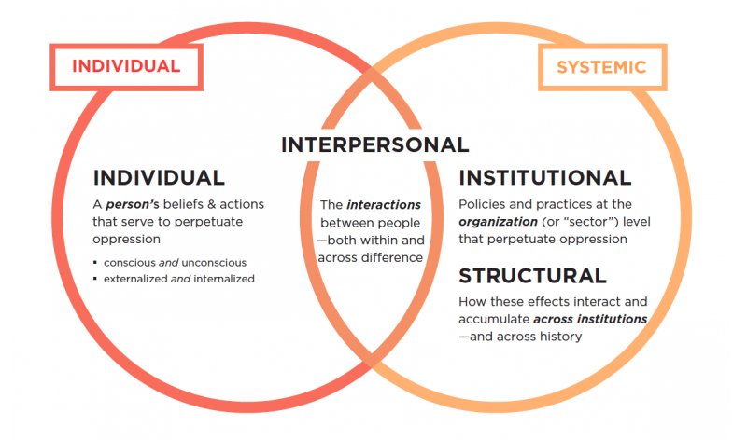
Social Position
The location in which an individual is situated within a social system or hierarchy. Social positions can include ascribed characteristics, such as race, ethnicity, and age, as well as achieved characteristics like education level, occupation, or income. In a hierarchical society, a person’s social positions influence their access to hold power. Positionality refers to one’s social positions.
Systemic Oppression
Systemic oppression includes marginalization or discrimination based on an individual’s social positions. Systemic oppression can occur at institutional or structural levels. Institutional levels refer to mental health policies or practices at a particular organization, whereas structural oppression includes mental health systems across institutions or historical mental health systems. It is critical to understand how positionality relates to systemic oppression. (“The Lens of Systemic Oppression,” n.d., para. 4).

Slide 18
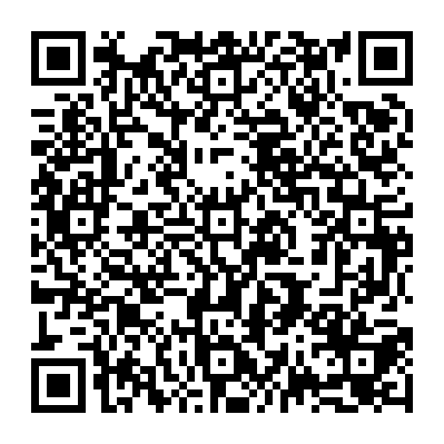
Resources
The Positionality Project, https://mhttcnetwork.org/centers/south-southwest-mhttc/positionality-project

Slide 19

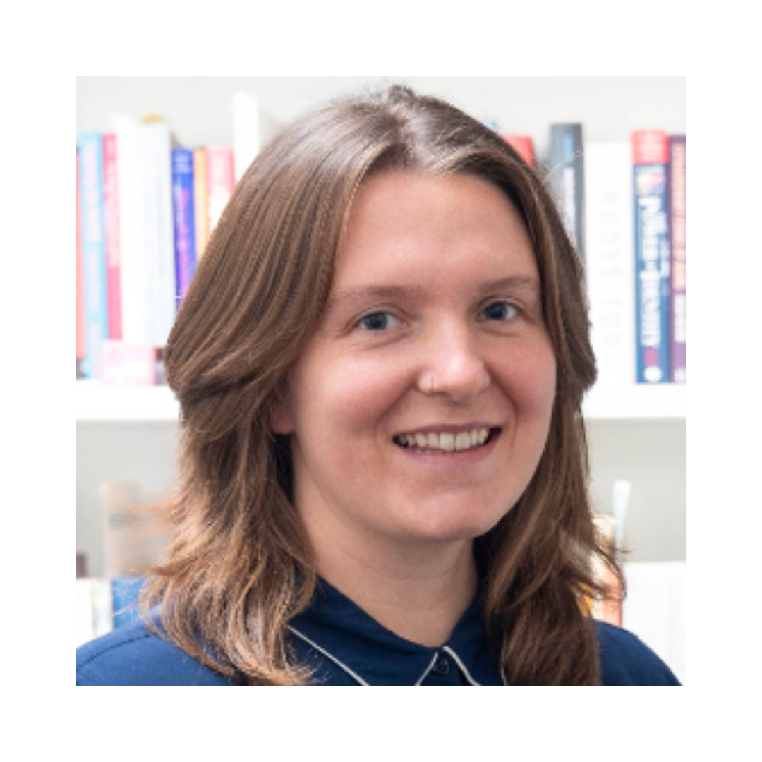
About the Authors
Grace Cruse, BA
(she/they)
I am a white, pansexual woman with living experiences of mental health conditions. My living experiences have inspired my passion for mental health awareness and advocacy. I believe that positionality in mental health is important because we can use it as a tool to center lived experiences in care and research and advocate for better representation and equity in mental health spheres.
Margaret Duvall, MA
(any pronouns)
As someone who holds a position of relative privilege in the United States–white, able-bodied, middle-class citizen with access to upward mobility through education–I work on analyzing ways that white supremacy culture shapes knowledge and discipline in the US. Although I identify as queer and gender fluid, I am generally able to keep these aspects of myself private until it is safe to share them. I believe an honest reckoning with position and privilege not only creates more just research but fosters humility and solidarity across difference.

Slide 20
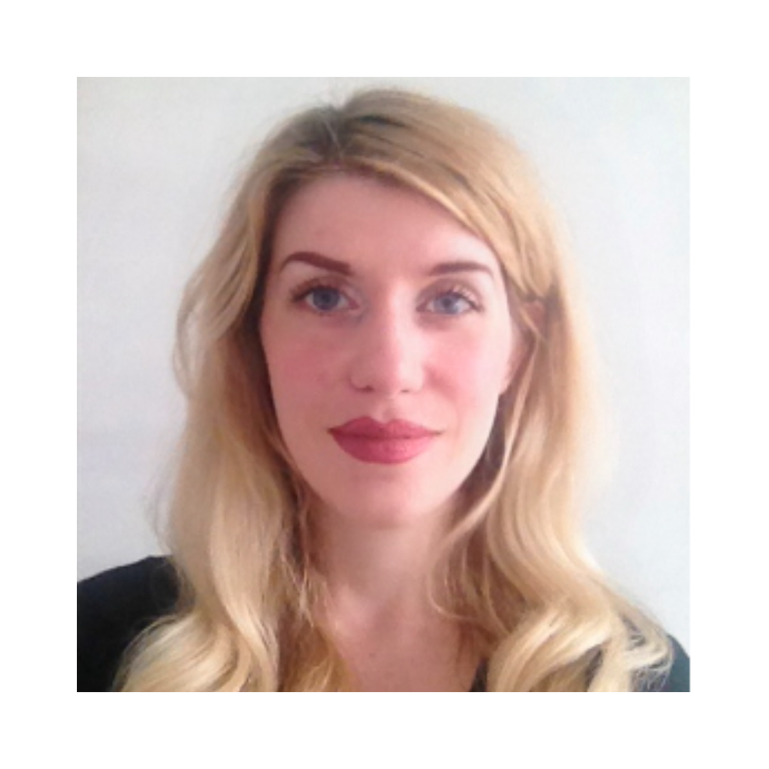
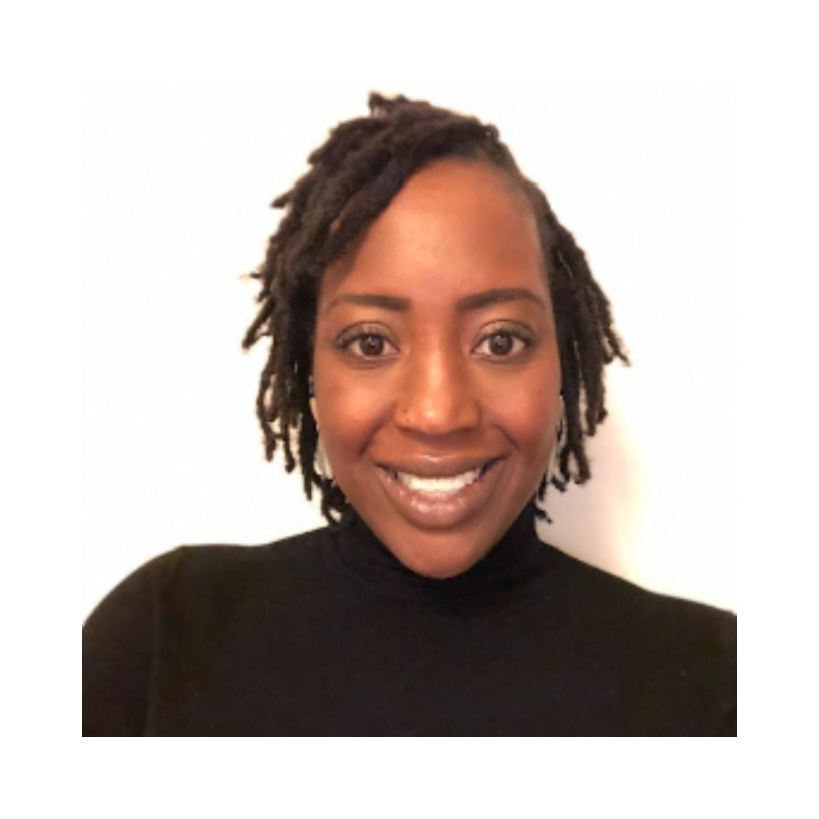
Eleanor Longden, PhD
(she/her)
I am a white, cis, college-educated woman whose work is strongly influenced by my lived experience of trauma and psychosis. Positionality has been an important means for me to reflect on my own perceptions and privileges, and I believe it has an invaluable role in helping foster more cooperative, collaborative, and person-centred approaches within mental healthcare. Given the impact of solidarity and inclusivity within my personal recovery journey, it has been an honour to collaborate on a project which is seeking to make these frameworks more broadly applicable and accessible across different communities in the future.
Oladunni Oluwoye, PhD
(she/her)
My positionality is shaped by experiences of marginalization as a Black woman and the privilege associated with having a PhD. It is through my own family’s experiences and that of being a Black person in the U.S that informs how I navigate life which includes my work. Work focused on shedding light and addressing inequities. But it is the lived experiences and stories from others that are shared with me that provide me with a better understanding.

Slide 21


Samantha J. Reznik, PhD
(she/her)
As a White Cis Woman with a PhD, I am a person with predominantly privileged social positions whose work focuses on individuals who have more marginalized social positions. I am alert to the potential for harm in my doing this work and reflection on my positionality is critical for me to mitigate such potential harms. My family’s multigenerational legacy of trauma motivates a passion for social justice, and positionality has helped me to collaborate across difference and center lived experience and marginalized perspectives to advance equity.
Mx. Yaffa, AS
(they/she)
As a trans, muslim, autistic, indigenous palestinian, mental health care, equity, and justice are deeply rooted in my survival. Positionality is a critical and essential framework that supports building equity into every sphere.

Slide 22
The purpose of the MHTTC Network is technology transfer - disseminating and implementing evidence-based practices for mental disorders into the field.
Funded by the Substance Abuse and Mental Health Services Administration (SAMHSA), the MHTTC Network includes 10Regional Centers, a National American Indian and Alaska Native Center, a National Hispanic and Latino Center, and a Network Coordinating Office.
Our collaborative network supports resource development and dissemination, training and technical assistance, and workforce development for the mental health field. We work with systems, organizations, and treatment practitioners involved in the delivery of mental health services to strengthen their capacity to deliver effective evidence-based practices to individuals. Our services cover the full continuum spanning mental illness prevention, treatment, and recovery support.

Slide 23
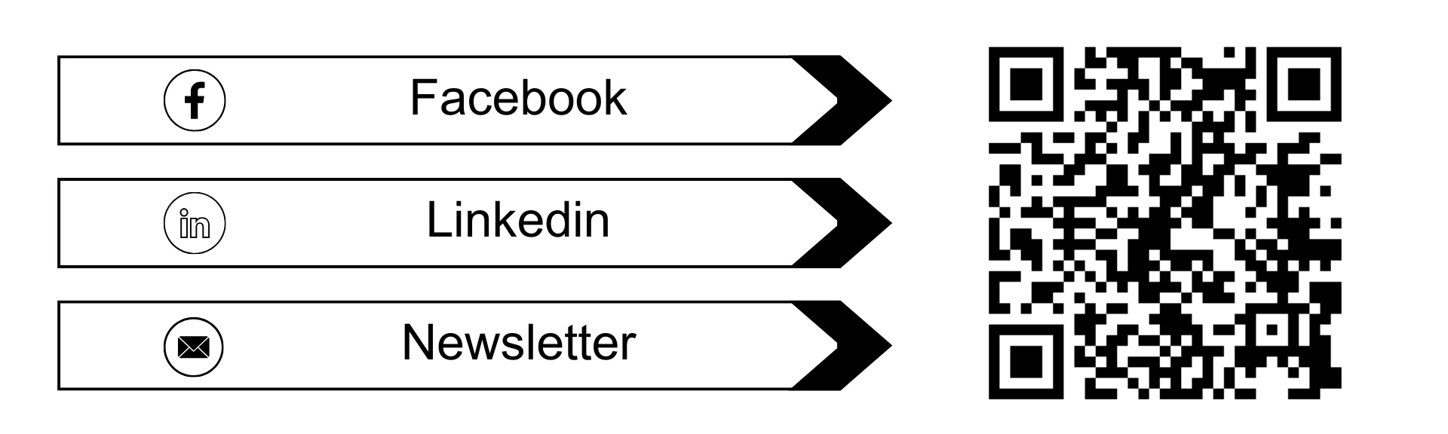
Let’s Stay Connected!

